Slide 1

Change in Early Voting from 2016 to 2020
David Larson
Link: https://mnscu-my.sharepoint.com/:p:/g/personal/le7858ey_go_minnstate_edu/EdVecnW-G2VHq4HUnBQmy4gBiOjRowVqRPVEtia0-R_YNA?e=zVAvOS

Slide 2
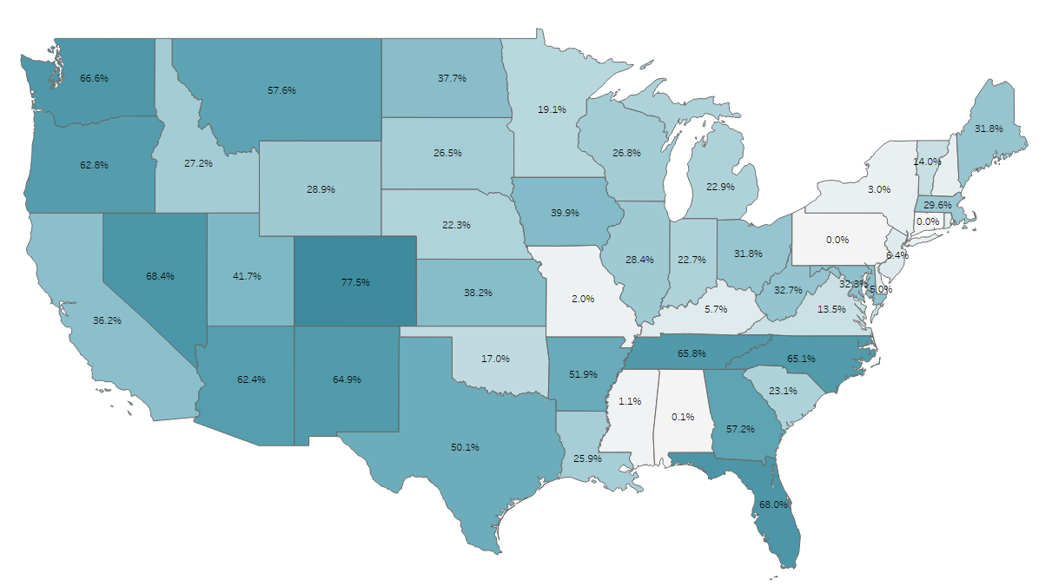
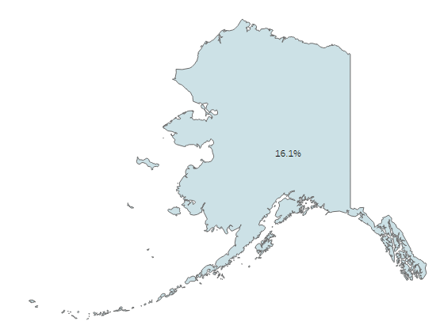
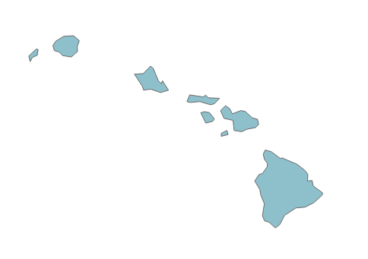

Percent Early Voting*
2016
Top Three:
Colorado (77.5%)
Nevada (68.4%)
Florida (68.0%)
46.1%
*Early Voting means either mail-in ballots or in-person voting before election day

Slide 3
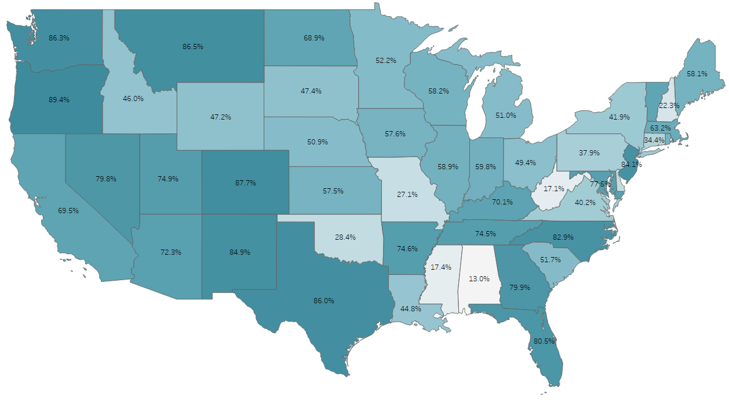
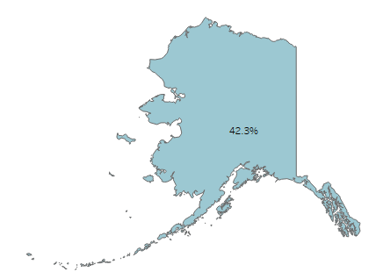
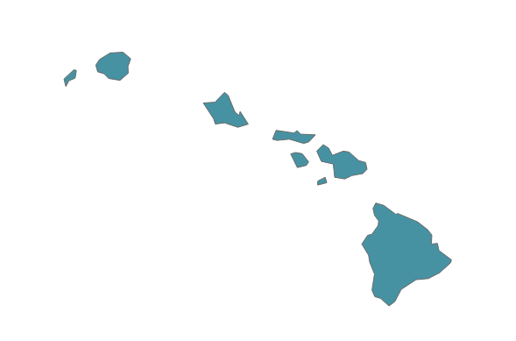
Percent Early Voting*
2020
Top Three:
Oregon (89.4%)
Colorado (87.6%)
Montana (86.5%)
83.6%
*Early Voting means either mail-in ballots or in-person voting before election day

Slide 4
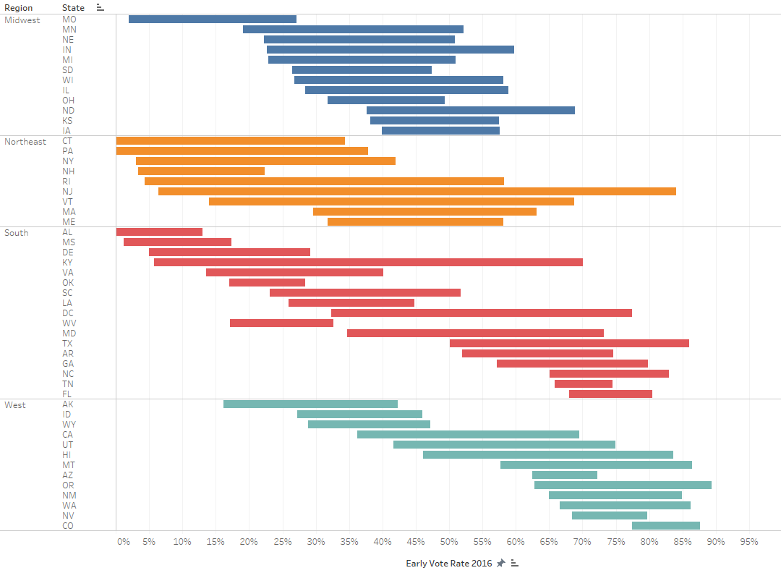
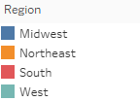
Change in Early Voting Percentage by State from 2016 to 2020
Top Three:
New Jersey (+77.7%)
Kentucky (+64.4%)
Vermont (+54.7%)
Notes:
- Avg. change is +27.1%
- West Virginia (-15.6%) is the only negative change

